Slide 1

Session 5 - 6
key risk management strategies, including:
regular organisational training
regular threat assessment (*covered in previous session)
cyber security incident response plan
clear escalation routes

Slide 2
Risk Management strategies
Risk management strategies are structured approaches to addressing risks and can be used in companies of all sizes and across any industry. Risk management is best understood not as a series of steps, but as a cyclical process in which new and ongoing risks are continually identified, assessed, managed, and monitored.
This provides a way to update and review assessments as new developments occur and then to take steps to protect the organization, people, and assets.

Slide 3
Regular organizational training
Education, Training, and Awareness (ETA) is a means to help address one of the most major issues within organisation security, users.
People are ultimately the weakest link in security. They are often gullible, fallible, and have access to the systems.
Roughly 85% of all ‘attacks’ are initiated from a user triggered action. These aren’t necessarily malicious, and are often accidental. Have you ever accidentally deleted your work?

Slide 4
Regular organizational training
Common training topics include:
Relevant information security policies | Relevant processes
Physical security | Wireless security
Password security | Social engineering
Desktop and Email security | Current risk landscape
High profile breaches | Best practices

Slide 5
Regular organizational training
ETA has come a long way, largely because we see major public incidents, vulnerabilities, and breaches reported on every other week.
However, within organisations, you will still need upper management support to address and instil a better security culture for the organisation.
People often retract from mandated approaches to training and education, but the aim is to make people more conscious and aware in the face of an incident.

Slide 6
Regular organizational training
One key component of organizational training is testing.
While individuals may take part in the training sessions, they need to be aware and cognisant of what is required, otherwise it is ineffective.
By testing your staff, you can ensure that knowledge gaps (and therefor human security vulnerabilities) are found.
This can also be applied to technical and risk/incident management teams to identify learning points and make improvements to the existing plans.

Slide 7
Regular organizational training
Examples of tests to be conducted:
End Users | Technical/Risk Teams
Phishing tests | Simulations
Q & A | Red Team exercises
Written tests | Tabletop discussions
Situational test (Role playing) | Call tree exercises

Slide 8
Regular organizational training
Ideas to make a training successful:
Keep sessions relevant and straight to the point.
Contextualize contents for different target audiences so that it is relatable.
Incentivize good cyber behaviours.
Ensure that tests are designed to identify gaps and not to fail the takers.
Gather feedback after every training to identify areas of improvements.

Slide 9
Importance of Incident Response plans
Resumes an ICT service to normal as quickly as possible after a disruption.
Aims to minimize negative impact on the business.
Prepare businesses for unexpected disruptions.
Demonstrating IT’s value to the business by aligning IT activities to business priorities
Reducing the impact on the business and user with improved monitoring
Meet legal & regulatory compliance.

Slide 10
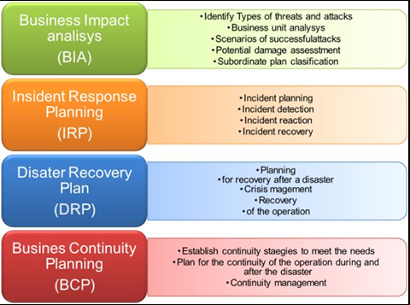
Types of Incident response plans
Business Impact Analysis (BIA)
Incident Response Plan (IRP)
Disaster Recovery Plan (DRP)
Business Continuity Plan (BCP)

Slide 11
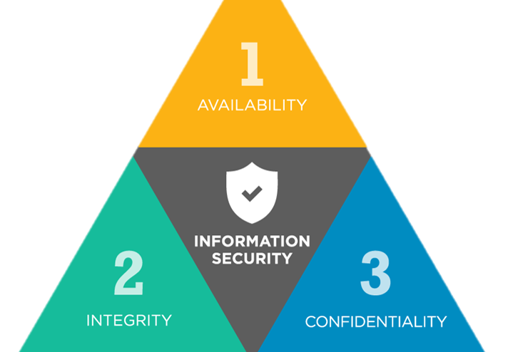
Incident response in Cyber Security
Back to basics, Cyber Security is all about maintaining the CIA Triad.
How does incident response planning help an organization to achieve that?

Slide 12
Incident Management Frameworks
ITIL
COBIT
ISO 27035:2011
NIST
CERT
SAN

Slide 13
Incident escalation
When an incident is reported, the best-case scenario is where the receiver of the incident report can resolve the problem quickly on their own.
Incident escalation is what happens when an employee can’t resolve an incident themselves and needs to hand off the task to a more experienced or specialized employee.
This usually happens when the existing knowledge base does not consist information for the reported incident.

Slide 14
Purpose of incident escalation
For companies following ITSM best practices, typically the service desk is at the center of incident escalation. If the first responder can’t resolve an incident, they circle back to the service desk, which escalates the issue to the appropriate next line of defense.
By having a well-planned incident escalation process, organisations can ensure that all incidents are managed at an appropriate level by the appropriate personnel.

Slide 15
Types of incident escalation
Hierarchical Escalation
Hierarchical escalation is when an incident is passed to a team or person based on their experience level or seniority within the organization.
Functional Escalation
Functional escalation is when an incident is passed to a team or person best equipped to resolve it based on their skills or systems knowledge, not their seniority.
Automatic Escalation
For teams working with an incident management platform/tool, you can also set up rules that tell the system to automatically escalate an incident if the primary on-call person doesn’t acknowledge or doesn’t close an alert.

Slide 16
Incident escalation matrix
An escalation matrix is a document or system that defines when escalation should happen and who should handle incidents at each escalation level.
The term is used across several industries. Human resources may have an escalation matrix for internal issues. Call centers may have an escalation matrix for customer service issues. And IT and DevOps teams may have one or more matrices that help engineers know how and when to escalate an incident.

Slide 17
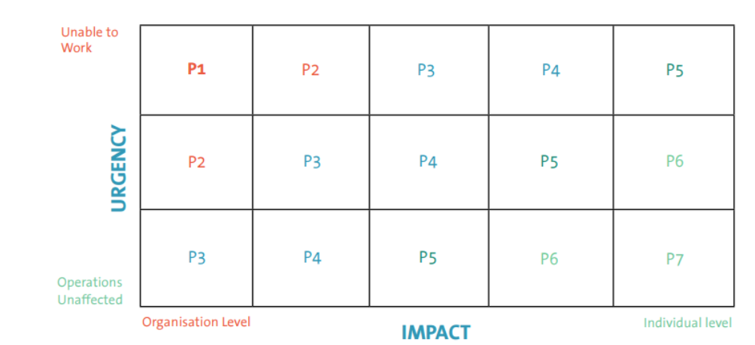
ITIL Incident priority matrix
Avoid generic terms that can be misinterpreted, leading to the wrong prioritisation in your escalation process.
Be specific. For impact, who is affected? The whole company, site, department, or one user?
For urgency, are the impacted people able to work, partially able to work, or completely unable to work?
Specific terms make it much clearer what you need to do and when you need to escalate.

Slide 18
Good practices of incident escalation
Treat your escalation policy as guidelines—not a hard and fast set of rules
Audit your on-call schedule regularly
Set smart thresholds for escalation
Set clear processes for escalation
These questions should be clearly addressed by your policy and clearly communicated to all on-call personnel in order to keep escalations running smoothly and resolve incidents faster.

Slide 19
Questions?

